Slide 1
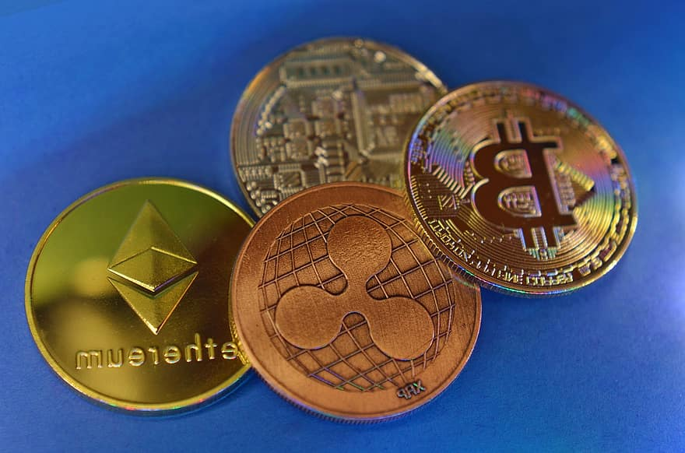
Understanding Cryptocurrency
Muhammad Taha

Slide 2
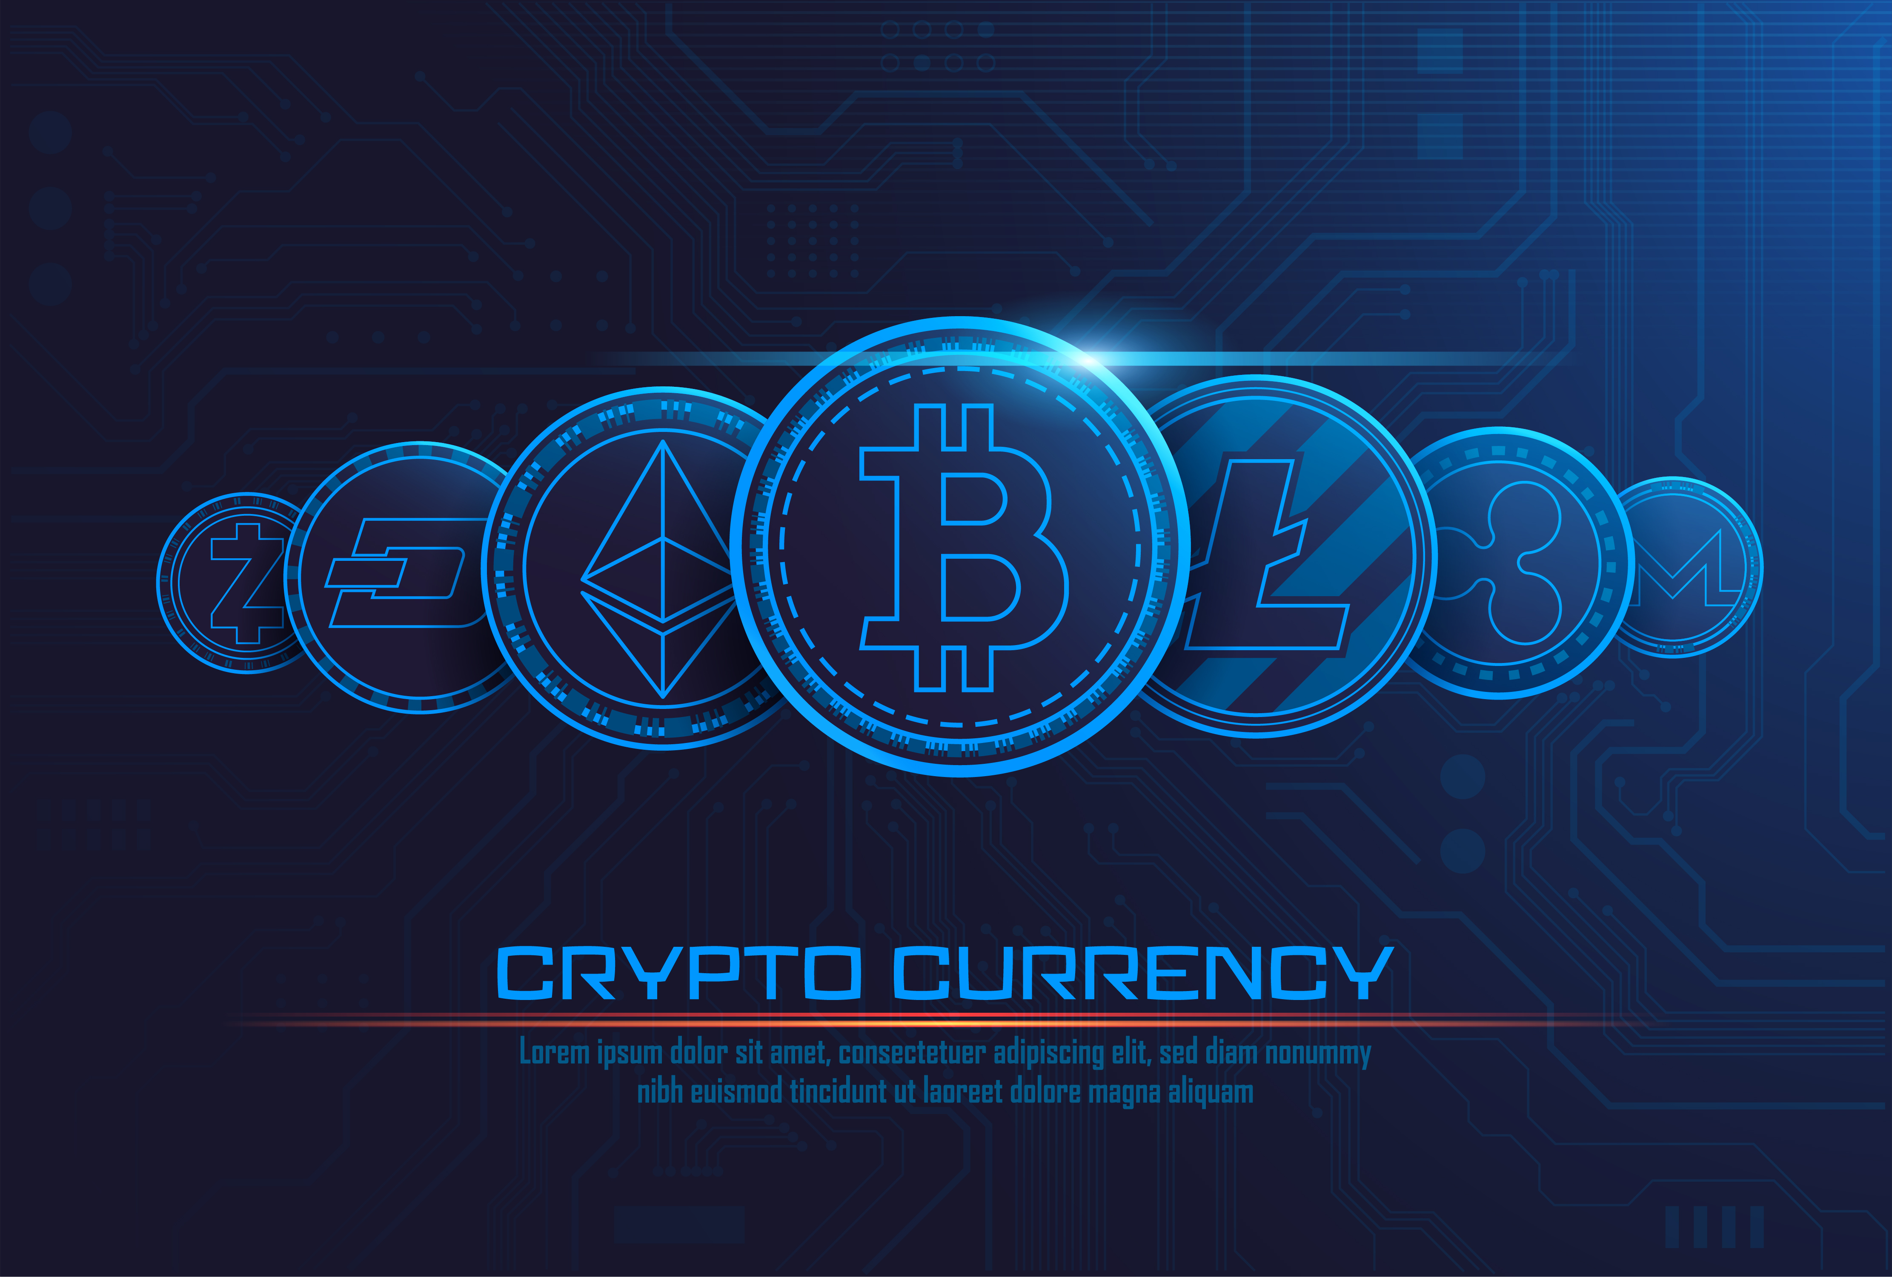
Introduction to Cryptocurrency
Cryptocurrency is a digital form of money secured by cryptography. It was created in 2009 with the introduction of Bitcoin by an anonymous person or group known as Satoshi Nakamoto. Cryptocurrency's main goal was to establish a decentralized and borderless system of money.

Slide 3
Benefits of Cryptocurrency && Challenges and Risks
Advantages of Cryptocurrency
Disadvantages of Cryptocurrency
Cryptocurrencies use strong encryption, making it secure and reducing the risk of fraud.
Transactions are often cheaper compared to traditional financial services.
Cryptocurrency can provide banking services to those without access to traditional banks.
Cryptocurrencies are accessible worldwide, eliminating the need for currency exchange.
Blockchain technology, behind cryptocurrencies, has spurred innovation in various industries
Cryptocurrency prices can be highly volatile, leading to financial risk.
Governments are still developing regulations, leading to uncertainty.
Hacks and scams can lead to the loss of funds.
Unlike traditional banks, cryptocurrency transactions are irreversible.
Not all merchants and businesses accept cryptocurrencies, limiting usability.

Slide 4
Some Well Known Cryptocurrencies
Bitcoin (BTC)
Ethereum (ETH)
Ripple (XRP)
The first and most famous cryptocurrency, often referred to as digital gold, used for a store of value and digital payments.
Known for its smart contract capabilities, it's a platform for building decentralized applications (DApps) and tokens.
Primarily designed for fast and low-cost cross-border transactions and used by financial institutions.

Slide 5


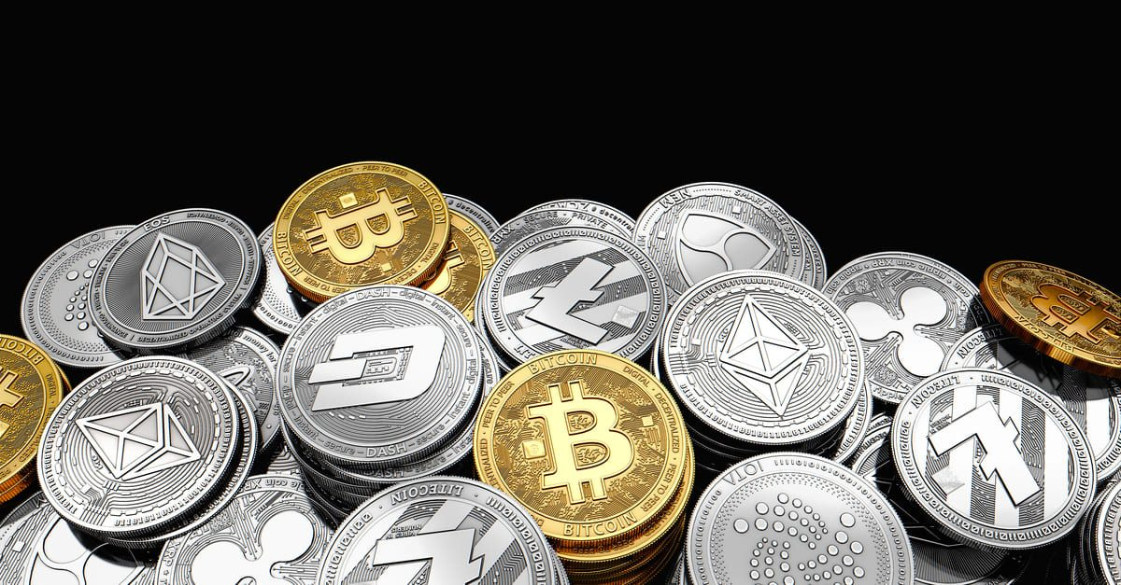

Summary
Cryptocurrency offers secure digital payments, automates agreements through smart contracts, cuts costs and time for cross-border remittances, acts as a store of value, powers decentralized applications (DApps), and enables asset tokenization, showcasing its versatile impact on our daily lives.

Slide 6
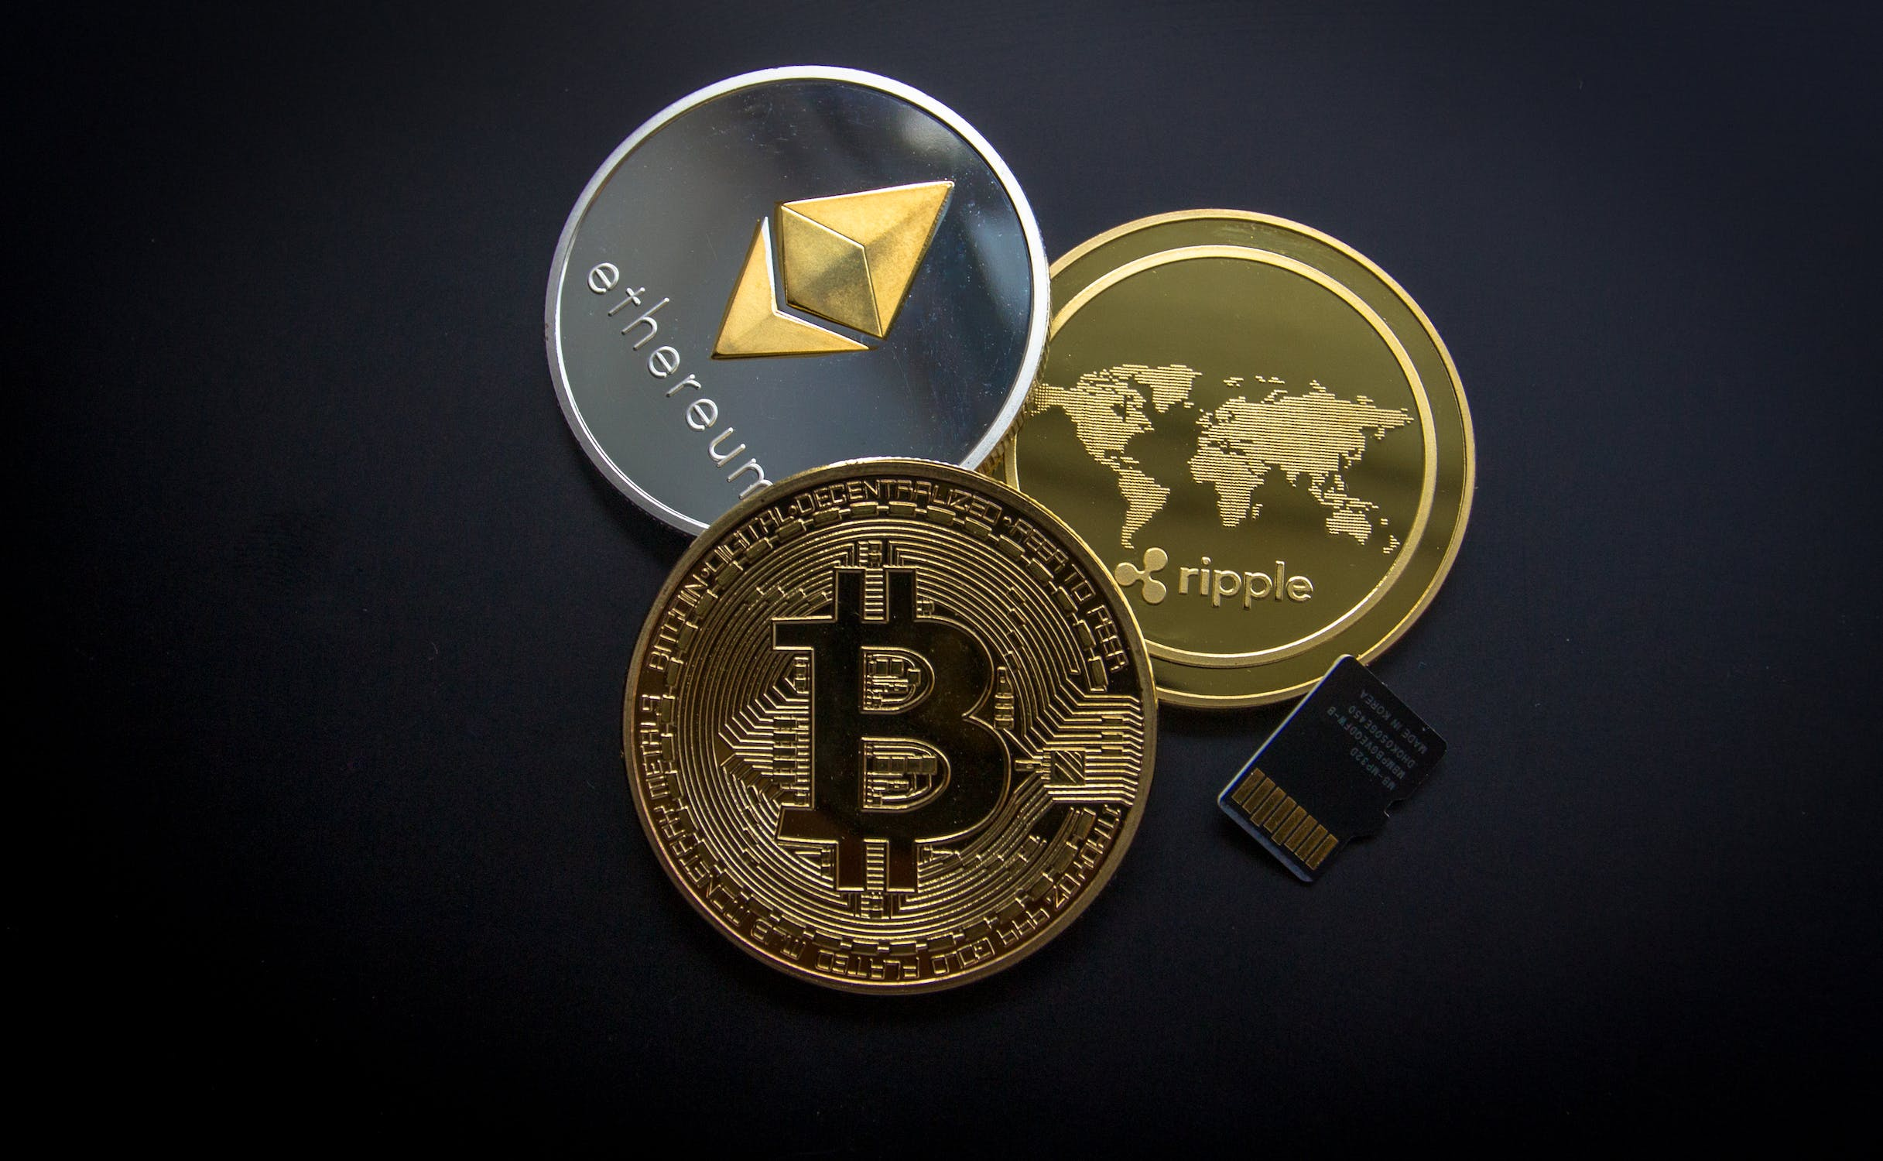
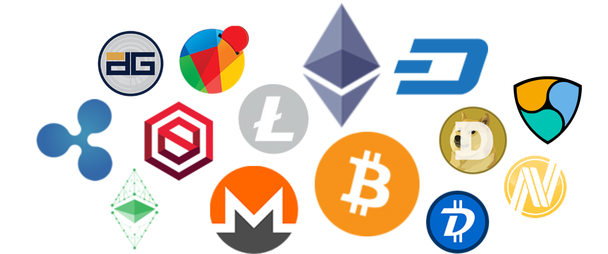
Thank you
Presenter name:
Muhammad Taha
Email address:
taha.@gmail.com
Website

